Slide 1
Welcome back!

Slide 2
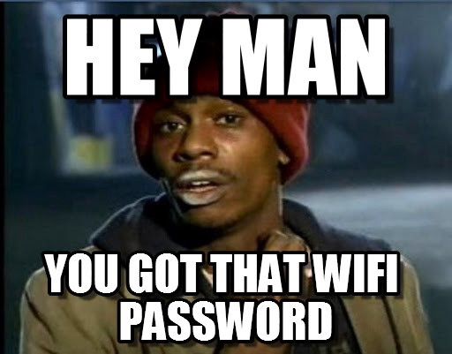

Slide 3
Goal of Phase 2
To prepare you technically and socially for placement in the New Zealand IT Industry.
You are expected to think for yourself in Phase 2. Show us what you have tried and your thought process.
Notes:
In the work place you are expected to think for yourself. You can ask for help, but not all environments are the same, and you may not always find someone who knows how to fix your exact problem.

Slide 4
Recap of MSA
You’ve built a web app using React + Type script
Source control using GitHub
Most of you have used Docker for deploying your front end
This section is NOT assessed. We just want to get to know you ☺.

Slide 5
Today’s schedule
Introduction (10am)
GitHub
User interface creation
Lunch (~12pm)
All things API (1:30pm)
Closing (4:30pm)

Slide 6
Tomorrow’s schedule
Introduction 10am
Deployment
Unit testing
Lunch (~12pm)
Accessibility(1:30pm)
Authentication
Expectations on other advanced features. (3:30pm)
Assessment briefing / Imagine Cup
Closing (4:00pm)

Slide 7
Assessment
24th November 2018
You must pass the in-person assessment to get placement
We assess both your technical skills and your soft skills.
We will release the criteria tomorrow.
Do NOT plagiarise
You will book your interview time, we will share the link tomorrow.
Notes:
Will be theory related questions in regard to all the features you have used and all those that you were expected to use.

Slide 8
Imagine Cup
All MSA students get direct entry to the Imagine Cup
We will share more details with you tomorrow.

Slide 9
Employer Networking Evening
Formal Attire
You will meet a subset of employers as a team
Your one chance to formally meet them
Drinks and nibbles afterwards – enjoy, but not too much
State your top employers in the form.
Read up on projects (Link will be shared)

Slide 10
Placement
December to February Fixed Time
Expectation of time, please determine with employers at evening
All employers will pay minimum of $1500 per placement to cover your costs, many may pay more (including full wage). You can discuss this.
You will get what you put into it.
Discuss leave and other concerns with employers.

Slide 11
FAQs
You can pull out of placement until Assessment Day
You are assessed as a team too – so work well or tell us
Help desk – Wednesday 21st November

Slide 12
Need Help or Advice?
nzmsa@microsoft.com

Slide 13
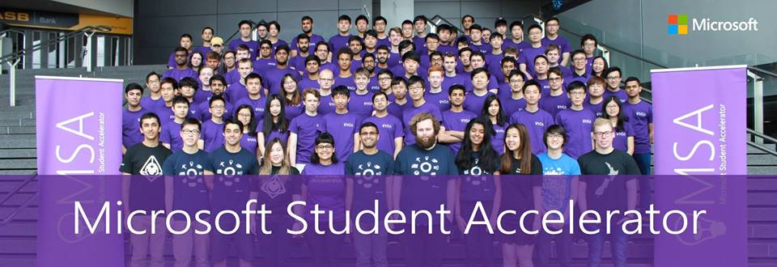
This will be you!
Notes:
Maybe in HD this year though. We will make sure it's at least 1080p

Slide 14
Questions?

